Slide 1

Indirect effects of contextual risks on children’s behaviour:
The role of maternal differential parenting
J.C. Meunier J.M. Jenkins M. Boyle T. G. O’Connor
University of Toronto University of MacMaster University of Rochester
2011 SRCD Biennial Meeting
Montreal, April 2, 2010
Notes:
The purpose of this study was to examine the effects of shared family risk on children’s behavioral outcomes and to look at the role that maternal Differential parenting may have within this relation. In other words, we looked at how family risk factor may impact children’s behavior not only directly – which has been recognized for a long time – but also indirectly through mother’s differential parenting.

Slide 2
Theoretical Framework
Differential Parenting (DP) as a negative phenomenon
  Social comparison (Festinger, 1954) & Distributive justice (Deutsch, 1985): If children treated very differently, increase in behavioural problem.
Parental capabilities as a resources
  The more resources parents have, the more equitable they will be (Low/Normative DP)
  But parents have a finite amount of resources…
Notes:
From the litterature, we know that DP is commonly recognized as a negative phenomenon in the family. According to the distributive justice framework, the more the children are treated differently the more they will be at risk for displaying behavioral problem.
Another point to consider in present study is the fact that the parental capabalities may be considered as resources. The more resources parents have, the more positive and equitable they will be for the children. But parents have a finite amount of resources and these resources may be limited by contextual adversity.

Slide 3
Theoretical Framework (cont.)
Family risk factors:
  e.g. poverty, depression, divorce,…
  Poorer children’s outcomes
  Limit parental resources : higher DP
    When resources devoted to cope with adversity, parents have less resources to pay attention to equitable treatment (preference,... Henderson et al., 1996)
Notes:
Hence, our interest to look at family risk factors. Family risk factors are risk that are shared by all members of the family. They may be, f.ex. poverty, parental depression, or divorce…
Many family risk factor are linked to a variety of poor children’s outcome and they are also recognized to limit parental resources.
The underlying idea is that when resources are devoted to cope with contextual adversity, parents become less equitable and may be driven by preferences or by child characteristics

Slide 4
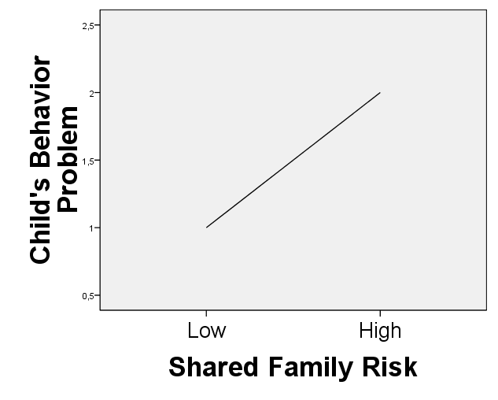
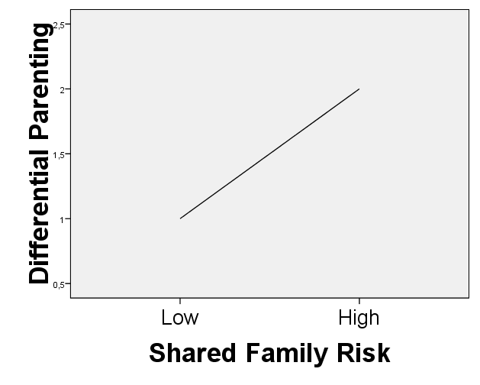
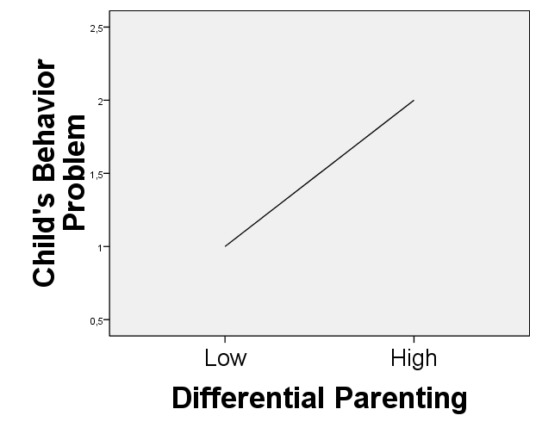
Theoretical Framework: In sum
Risk factors-Child’s behavior Risk factors-DP
DP-Child’s behavior
  How are these variables related ?
Notes:
In sum, links have been found between shared family risk, DP and children’s outcomes.
Higher risk is related to poorer child’s outcome and to higher DP
Higher DP is related to poorer outcomes.
Despite these recognized one-to-one associations, there is a lack of understanding of how these variables might be complexly related.

Slide 5
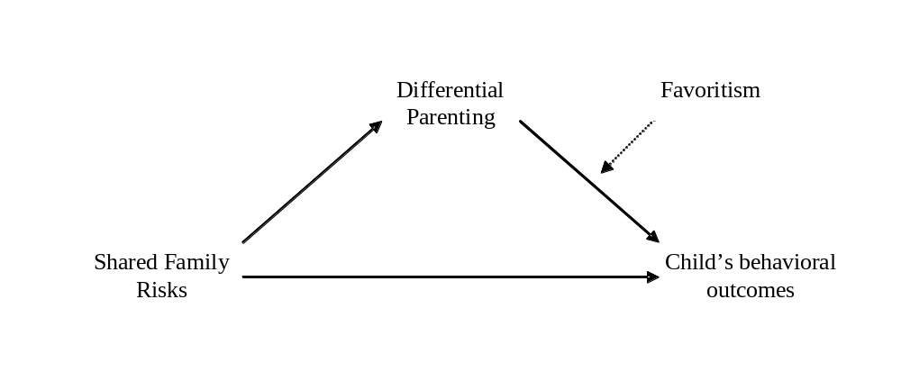
Primary hypothesis
Children affected by shared family risk factors both directly and indirectly through DP
  At the Family Level (mediation)
    Deleterious for all children in the family (magnitude of DP)
Family Level
Family Level
Family Level
Notes:
The primary hypothesis in present study was that children would be affected by risk factors both directly and indirectly through DP.
This process is supposed to operate at the family level. The higher the family risk, the higher variability in treatment the parents will display across all sibling in the family. And this phenomenon will be deleterious for all siblings.

Slide 6
Secondary hypothesis
Indirect effect through DP should be worst for the disfavored child
  At the Child Level (moderated mediation)
    More deleterious for the disfavored child (direction of DP)
Child Level
Family Level
Family Level
Child Level
Notes:
Corolarly, the secondary hypothesis sought to look at the specific child. It was hypothesized that the indirect of family risk through DP should be worst for the disfavored child. In other word, the family risk increase the variability of parenting across the sibling and this variability will have increased negative impact on the child which is more strongly disfavored.

Slide 7
Method: Sample
920 children nested in 397 families
  Up to 4 children/families
Children’s age and gender
  Age : M=3.51 (SD = 2.38)
  Gender: 475 boys, 445 girls
Siblings age and gender composition
  Age difference : M=2.27 (SD= 1.19)
  Gender: 229 mixed gender, 89 all-boy, 79 all-girl
Two-waves : Risk (T1), DP & Child’s behavior (T2)
Notes:
The study was conducted in a sample of the 920 children nested in 397 family. We had up to 4 children / families.
The mean age of the sample was 3.51 and the gender ratio was close to 50 percent.
As for sibling composition, the mean age gap was 2.27 and there was a majority of mixed gender dyad, more than two hundred as compared to 89 all-boy dyad and 79 all-girl dyad.
This is a semi longitudinal mediation design, where the predictors were assessed at T1 (the contextual risk factors) and the mediator and outcomes were assessed at T2 (this is differential parenting and children’s outcomes)

Slide 8
Method: Measures
Shared family risk
  Mother’s educational level (self-reported)
  Family type (self-reported)
    Lone-parent- and Step-families Vs. Two-parent-families
  Maternal depression (self-reported)
    CES-D (Radloff, 1977)
  Maternal history of abuse (self-reported)
    CEVQ (Walsh et al., 2008)
  Household chaos (independant observer)
    4 items from HOME (Bradley & Caldwell, 1981) : order, cleanliness and safety of physical environment
Notes:
We considered the following risk factors
Mother’s educational level, by the the number of succesfull education years
Family type, by comparing step-families and lone-parents families to intact families. This was assessed at time 2 because family status could have changed between T1 and T2. For this reason, keeping family type status from T1 could have led to some spurious results.
Mother’s depression was assessed by mothers’rating with the depression scale from the center from epidemiological study.
Mother’s history of physical and sexual abuse was also assessed through self-report by completing the Childhood Experience of Violence Questionnaire.
Finally we also looked at a more proximal risk which is the chaos in the home environment, and this was done by an external observer that assessed the home environment from the HOME assessment on order, cleamliness and safety.

Slide 9
Method: Measures (cont.)
Family level DP (negativity)
  Self-reported (all siblings, N=920)
    Parenting towards each siblings
    Negativity (NLSCY, 1995)
  Observed (two youngest siblings, N=794)
    Mother interacting with the two kids
    Mean Negative affect and Negative control (CARP, Matias et al., 2006; PARCHISY, Deater-Deckard et al., 1997)
  Scores : Family SD
Favoritism score
  Dummy code : Equal treatment and favoured Vs. Disfavoured
Notes:
For the mothers’ DP, we had two measures to increase the reliability of our results. A self-reported measures and an objective measure.
For the self-report mothers assessed their negative parenting behavior toward each of the participating children by completing the negativity scale developped for the NLCSY study.
Observational measure was obtained only for the two youngest kids through a 15min session of mothers interacting with these two kids. Rating was done the negative affect scale from the CARP and the negative controlling from the PARCHISY. We used a combined mean score from these two scale.
For both observation and self-report, Family-level DP score was obtained by computing the family SD on the parenting measure.
From the parenting scores, we also compute a favoritism score. This was done by a dummy code for the favored kids versus the disfavored kids. Favored category also included equally treated children.

Slide 10
Method: Measures (cont.)
Children’s behaviour (parents’ report)
  Aggression, Emotional & Attentional problem
    Ontario Child Health Study (Boyle et al., 1993)
    Averaged mothers-fathers’ scores
  Social relationships
    Ontario Child Health Study (Sanford et al., 1992)
    Mothers’ scores
Notes:
Finally the behavioral outcomes considered in present study were conduct, emotional attentional problem as well as social relationships quality. These scales all come from the Ontario Child Health Study.
The scale for aggression, emotional and attentional problem were assessed by the two parents and averaged.
For the social relation scale we had only mother’s reports.

Slide 11
Method: Procedure
a.
b.
c.
Simple effects
  Path a
    On DP: Controlling for sibling age and gender composition
  Paths b & c
    On Child’s behaviour: Controlling for age and gender
Mediation (Delta method)
    Indirect: ‘a x b’ (Sobel, 1982)
    Each outcome: 12 tests (6 predictors, 2 mediators)
Moderated mediation (Delta method)
    Difference in ‘a x b’ for fav/disfav (Praecher et al., 2007)
Stats : ML, multiple imputation (bootstrap not possible)
Notes:
The first part of the study was intended to look at simple effects between predictors, mediators and outcomes.
In the mediation framework,
In the first set of analyses we looked at the effects of the risk factor. The direct effect and the indirect effect through an increase in DP.
Home order was found to have a direct effect on conduct, emotional and attentional problem but not on social relationships quality.
Indirect effect was found for emotional, attentional problem and for social relationships.
It is important to note that home order doesn’t affect social relationships directly but only by increasing DP.
In sum,
We only found direct effect for conduct problem
We found both direct and indirect effects for emotional and for attentional problem
And we only found indirect effect for social relations
I am showing you here a summary for the indirect effect and the predictors and outcomes for which we find this indirect to be strongest.
Please note though that maternal depression and maternal history of abuse were also associated with differential parenting but the full indirect effect was ns.
I am showing you here a summary for the indirect effect but for observed parenting and the predictors and outcomes for which we find this indirect to be strongest.
Please note though that maternal depression and maternal history of abuse were also associated with higher levels of differential parenting with the observation but the full indirect effect was ns.
The second set of analyses addressed the following questions : does the indirect effect of family risk through DP change if the child is favored or disfavored.
The response was no for the observed measured of DP. The observed favoritism doesn’t change the indirect effect.
As opposed, we found a drastic change for the mothers rating of favoritism :
in other word the indirect effect of risk though DP was much stronger for the child who was reported to be disfavored by the mothers.
And for the child being favored, the indirect effect through DP were no longer significant.

Slide 12
Results: Simple effects
Path a*
  Household chaos, lone-parent, depression, history of abuse,educational level, step-families
Path b*
  Emotional, attentional problem and social relationships
Path c
  20/24 sig. (6 risks on 4 outcomes)
a.
b.
c.
* Underlined: shown for the 2 DP measures. Not underlined: shown for only 1 DP measure.

Slide 13
Results: Aggression
Mediation
  No sig. mediation
Moderated mediation (fav/disfav)
  Only for mothers’ report of DP
  5 Diff. Sig.: step-families, lone-parent-families, depression, history of abuse and household chaos
a. x b.

Slide 14
Results: Emotional problem
Mediation
Moderated mediation (fav/disfav)
  Only for mothers’ report of DP
  2 Diff. Sig.: step-families and lone-parent-families
- Educational level*
- Step-families*
- Household chaos*
a. x b.
* Underlined: shown for the 2 DP measures. Not underlined: shown for only 1 DP measure.

Slide 15
Results: Attentional problem
Mediation
Moderated mediation (fav/disfav)
  Only for mothers’ report of DP
  1 Diff. Sig.: Household chaos
- Educational level*
- Step-families*
- Lone-parent-families*
- Depression*
- History of abuse*
- Household chaos*
a. x b.
* Underlined: shown for the 2 DP measures. Not underlined: shown for only 1 DP measure.

Slide 16
Results: Social Relation
Mediation
Moderated mediation (fav/disfav)
  Only for mothers’ report of DP
  2 Diff. Sig.: Step-families and household chaos
- Educational level*
- Step-families*
- Lone-parent-families*
- Depression*
- History of abuse*
- Household chaos*
a. x b.
* Underlined: shown for the 2 DP measures. Not underlined: shown for only 1 DP measure.

Slide 17
Conclusion
Direct effects of risk for each behavior (path c)
Indirect effects partially confirmed (mediation)
  For all risks
  Especially on Attentional problem and Social relations
  In some cases: cascade effects
    e.g. Household chaos only affect social relations indirectly through increased DP
Importance of mother’s report of favoritism (moderated mediation)
  Stronger indirect effect for the child reported to be disfavored : especially for Aggression
Notes:
To conclude.
As suggested in the litterature, we found direct effects of family risk factors for each considered behavior.
Also, the indirect effect hypotheses was partially confirmed. We found some evidence of indirect effect through DP for all risks factors we considered and especially on attentional and on social relationships quality.
In some case, we also found cascade effects : f’ex. As I showed you, home order doesn’t affect social relations quality directly but only by increasing differential parenting.
Finally, the importance of mother’s report of favoritism was highlighted. And this suggested that the negative effect of family risk on children’s outcome is particularly evident for the child reported to be disfavored by the mother. And this was especially true for Agression.

